Slide 1
Device Driver

Slide 2
Device Driver
device driver or software driver is a computer program allowing higher-level computer programs to interact with a hardware device.
device driver simplifies programming by acting as translator between a hardware device and the applications or operating systems that use it
Drivers are hardware-dependent and operating-system-specific

Slide 3
Writing a device driver requires an in-depth understanding of how the hardware and the software of a given platform function. Drivers operate in a highly privileged environment and can cause disaster if they get things wrong

Slide 4
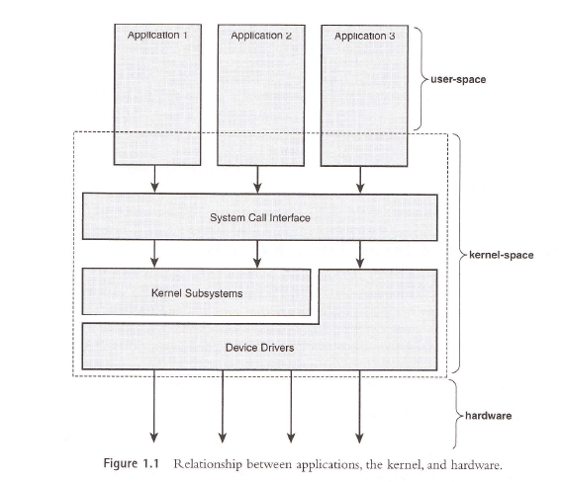
Kernel Basics

Slide 5
Kernel basics
No libc functions!!!
  No printf, use printk instead
  Some common functions implemented inside the kernel
No memory protection
  Oops
  Not Pageable
Small, fixed size stack
Synchronization and Concurrency issues

Slide 6
Kernel Functions
copy_to_user()
copy_from_user()
vmalloc()
alloc_pages(), alloc_page()
free_pages(), free_page()
kmalloc(), kfree()
vmalloc(), vfree()

Slide 7
Proc filesystem
Virtual Files
Important Functions:
  create_proc_entry()
  remove_proc_entry()
Other Functions:
  create_proc_read_entry()
  proc_mkdir()
  proc_symlink()

Slide 8
Device Types
Block devices
  Random access devices (buffering) For example a file system can only be mounted on a block device, because it requires random access.
  For example, disks are commonly implemented as block devices.
Character devices
  Sequential access (no buffering). Examples might include printers, scanners, sound boards, &c.
  The same device may have both block and character oriented interfaces (In other UNIX this would actually require separate drivers. A block device driver and a raw device driver.)

Slide 9
Device Drivers
Character devices
Block devices
Major number
  typically associated with the driver
Minor number
  Typically associated with physical instance of device

Slide 10
Device Driver Types
A character device driver ( c )
  Most devices are this type (e.g.Modem, lp, USB
  No buffer.
A block device driver (b)
  through a system buffer that acts as a data cache.
  Hard drive controller and HDs

Slide 11
Major and Minor Numbers
Major number
  Each device driver is identified by a unique major number. This number is assigned by the Linux Device Registrar. This number is the index into an array that contains the information about the driver (the device_struct)
Minor number
  This uniquely identifies a particular instance of a device. For example, a system may have multiple IDE hard disks each would have a major number of 3, but a different minor number.
mknod /dev/name type major minor
In UNIX, the interface to devices is via the file system. To create a file representing a device, you use mknod and supply the filename and the device’s type (c for character or b for block) and the device’s major and minor number.

Slide 12
Implementation
Assuming that your device name is Xxx
Xxx_init() initialize the device when OS is booted
Xxx_open() open a device
Xxx_read() read from kernel memory
Xxx_write() write
Xxx_release() clean-up (close)
init_module()
cleanup_module()

Slide 13
Driver program
#include <linux/module.h> /* Needed by all modules */
#include <linux/kernel.h> /* Needed for KERN_INFO */
int init_module(void)
{
printk(KERN_INFO "Hello world 1.\n");
/* A non 0 return means init_module failed; module can't be loaded. */
return 0;
}
void cleanup_module(void)
{
printk(KERN_INFO "Goodbye world 1.\n");
}

Slide 14
printk()
- not meant to communicate information to the user.
- logging mechanism for the kernel, and is used to log information or give warnings.
- printk() statement comes with a priority
-If the priority is less than (int)console_loglevel, the message is printed on your current terminal. If both syslogd and klogd are running, then the message will also get appended to /var/log/messages

Slide 15
Makefile is a script for appropriate compilation of different type of sources to the appropriate object code.
To use a makefile just type make or gmake in a console window opened in the same dir as the makefile

Slide 16
Makefile
obj-m += hello-1.o
all:
make -C /lib/modules/$(shell uname -r)/build M=$(PWD) modules
clean:
make -C /lib/modules/$(shell uname -r)/build M=$(PWD) clean

Slide 17
Commands to run module
$ make
$ insmod hello.ko
$ lsmod | less
$ tail –f /var/log/messages
$modinfo hello.ko
$ rmmod hello
$ tail –f /var/log/messages

Slide 18
kernel functions
add_timer()
  Causes a function to be executed when a given amount of time has passed
cli()
  Prevents interrupts from being acknowledged
end_request()
  Called when a request has been satisfied or aborted
free_irq()
  Frees an IRQ previously acquired with request_irq() or irqaction()
get_user*()
  Allows a driver to access data in user space, a memory area distinct from the kernel
inb(), inb_p()
  Reads a byte from a port. Here, inb() goes as fast as it can, while inb_p() pauses before returning.
irqaction()
  Registers an interrupt like a signal.
IS_*(inode)
  Tests if inode is on a file system mounted with the corresponding flag.
kfree*()
  Frees memory previously allocated with kmalloc()
kmalloc()
  Allocates a chu nk of memory no larger than 4096 bytes.
MAJOR()
  Reports the major device number for a device.
MINOR()
  Reports the minor device number for a device.

Slide 19
kernel functions
memcpy_*fs()
  Copies chunks of memory between user space and kernel space
outb(), outb_p()
  Writes a byte to a port. Here, outb() goes as fast as it can, while outb_p() pauses before returning.
printk()
  A version of printf() for the kernel.
put_user*()
  Allows a driver to write data in user space.
register_*dev()
  Registers a device with the kernel.
request_irq()
  Requests an IRQ from the kernel, and, if successful, installs an IRQ interrupt handler.
select_wait()
  Adds a process to the proper select_wait queue.
*sleep_on()
  Sleeps on an event, puts a wait_queue entry in the list so that the process can be awakened on that event.
sti()
  Allows interrupts to be acknowledged.
sys_get*()
  System calls used to get information regarding the process, user, or group.
wake_up*()
  Wakes up a process that has been put to sleep by the matching *sleep_on() function.

Slide 20
Types of Drivers, Driver History, Driver Issues, Kernel Level Device drivers, Virtual device drivers(VxD),Writing a Driver, Device Driver Stack Buses and Physical Devices,
Static Device drivers, Dynamic Device drivers, Device Installation and .Inf files, PnP,
Device Namespace, and Named Devices.

Slide 21
kernel headers are more than sufficient to compile kernel modules / drivers

Slide 22
Virtual device drivers
used to emulate a hardware device, particularly in virtualization environments
Instead of enabling the guest operating system to dialog with hardware, virtual device drivers take the opposite role and emulate a piece of hardware, so that the guest operating system and its drivers running inside a virtual machine can have the illusion of accessing real hardware

Slide 23
VxD(virtual xxx driver)
A virtual device driver (VxD) is a software device driver that emulates hardware and other devices so that multiple applications running in protected mode can access hardware interrupt channels, hardware resources and memory without causing conflicts.
To share arbitrary physical resources amongst these virtual machines, Microsoft introduced dynamically-loadable virtual device drivers.

Slide 24
In Windows, a device driver is controlled by the operating system's virtual device driver manager (VDDM) and is shared by the applications running within that kernel
There was no hardware device sharing allowed in most standard DOS applications, so the virtual device driver (VxD) was introduced to prevent device access conflicts. The VxD passed interrupt and memory requests through to the kernel, which in turn allocated the resources as required, always ensuring only a single request thread could access a single interrupt channel of any device at any one time

Slide 25
User mode and kernel mode
A processor in a computer running Windows has two different modes: user mode and kernel mode.
The processor switches between the two modes depending on what type of code is running on the processor.
Applications run in user mode, and core operating system components run in kernel mode. Many drivers run in kernel mode, but some drivers run in user mode.
When you start a user-mode application, Windows creates a process for the application.
The process provides the application with a private virtual address space and a private handle table. Because an application's virtual address space is private, one application cannot alter data that belongs to another application.
Each application runs in isolation, and if an application crashes, the crash is limited to that one application. Other applications and the operating system are not affected by the crash.

Slide 26
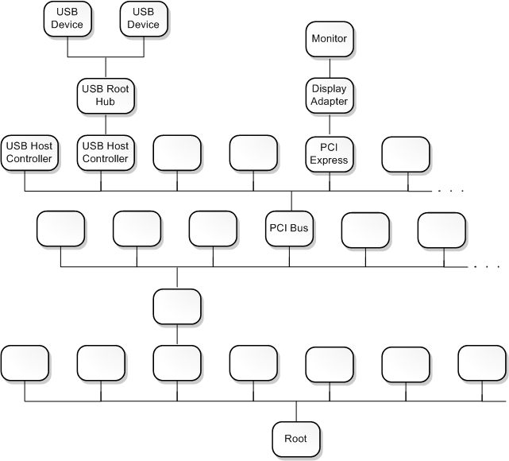
Device nodes and device stacks
Windows organizes devices in a tree structure called the device tree
node in the device tree is called a device node

Slide 27
Device objects and device stacks
A device object is an instance of a DEVICE_OBJECT structure.
Each device node has an ordered list of device objects, and each of these device objects is associated with a driver.
The ordered list of device objects, along with their associated drivers, is called the device stack for the device node.
first device object to be created in the device stack is at the bottom, and the last device object to be created and attached to the device stack is at the top

Slide 28
Driver stacks
In the Windows operating system, WDM drivers are layered in a vertical calling sequence that is called a driver stack.
The topmost driver in the stack typically receives I/O requests from user applications, after the requests have passed through the operating system's I/O manager. The lower driver layers typically communicate with computer hardware.

Slide 29
Device stacks
Each driver stack supports one or more device stacks. A device stack is a set of device objects that are created from WDM-defined DEVICE_OBJECT structures. Each device stack represents one device. Each driver creates a device object for each of its devices and attaches each device object to a device stack. Device stacks are created and removed as devices are plugged in and unplugged, and each time the system is rebooted.
When a bus driver detects that child devices have been plugged in or unplugged, it informs the Plug and Play (PnP) manager. In response, the PnP manager asks the bus driver to create a physical device object (PDO) for each child device that is connected to the parent device (that is, the bus). The PDO becomes the bottom of a device stack.
Next, the PnP manager loads function and filter drivers to support each device (if they are not already loaded), and then the PnP manager calls these drivers so that each can create a device object and add it to the top of the device stack. Function drivers create functional device objects (FDOs), and filter drivers create filter device objects (filter DOs).
When the I/O manager sends an I/O request to a device's drivers, it passes the request to the driver that created the topmost device object in the device stack. If that driver asks the I/O manager to pass the request to the next-lower driver, the I/O manager uses the device stack to determine the next-lower driver. (The next-lower driver is the driver that created the next-lower device object.)

Slide 30
Function drivers, filter drivers, and bus drivers
Each driver in a device stack plays the role of either function driver, filter driver, or bus driver.
main driver for the device stack is called the function driver for the device stack or the function driver for the device node
function driver is responsible for handling read requests, write requests, and device control requests
device object that is associated with a function driver is called a functional device object (FDO).

Slide 31
driver at the bottom of the device stack is called the bus driver for the device stack or the bus driver for the device node.
A device object that is associated with the bus driver for a device stack is called a physical device object (PDO).
A driver that is above the function driver or in between the bus and function drivers is called a filter driver.
A device object that is associated with a filter driver is called a filter device object (Filter DO).

Slide 32
.inf, PnP
When the drivers for a device are installed, the installer uses information in an information (INF) file to determine which driver is the function driver and which drivers are filters.
Typically the INF file is provided either by Microsoft or by the hardware vendor.
After the drivers for a device are installed, the Plug and Play (PnP) manager can determine the function and filter drivers for the device by looking in the registry.

Slide 33
Buses and bus drivers
A bus is any parent node in the device tree. In other words, any device node that has one or more child nodes is a bus.
The bus driver for a device node is the driver associated with the PDO at the bottom of the node's device stack.

Slide 34
2. A bus is a physical device that can have other physical devices connected to it. For example, the PCI bus is a set of conductors and circuitry on the motherboard, and devices are connected to the PCI bus by being built into the motherboard or by being plugged into expansion slots. Physical USB devices can be connected to a USB host controller.
A bus driver is the function driver associated with a physical bus

